Slide 1
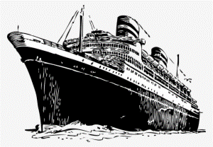
Titanic Data Analysis Project
Presentation by IJAZ KHAN

Slide 2
Introduction
Project Overview
Objective
Analyzing the Titanic dataset to identify the key factors that influenced the survival of passengers.
To understand the demographics and characteristics of survivors and non-survivors using data analysis techniques.

Slide 3
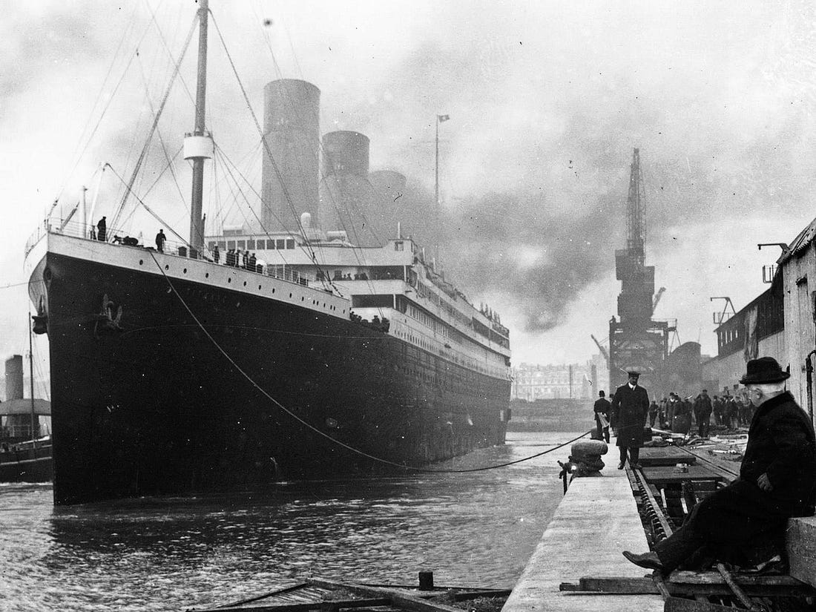
Dataset Description
Source
The Titanic dataset from Encryptix.

Slide 4
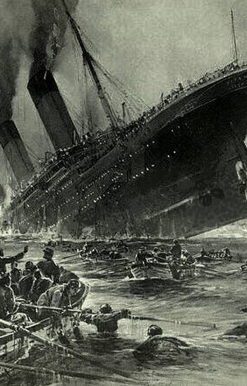
Data Preprocessing
Steps Involved
Tools Used
Handling missing values (e.g., Age, Cabin, Embarked), Encoding categorical variables (e.g., Sex, Embarked), Feature scaling (e.g., Fare).
Python (Pandas, NumPy), Jupyter Notebook.

Slide 5

Exploratory Data Analysis (EDA)
60%
40%
Demographic Analysis
Key Insights
Distribution of age, gender, and class among passengers.
Majority of passengers were in the third class. A higher proportion of male passengers compared to female passengers.

Slide 6
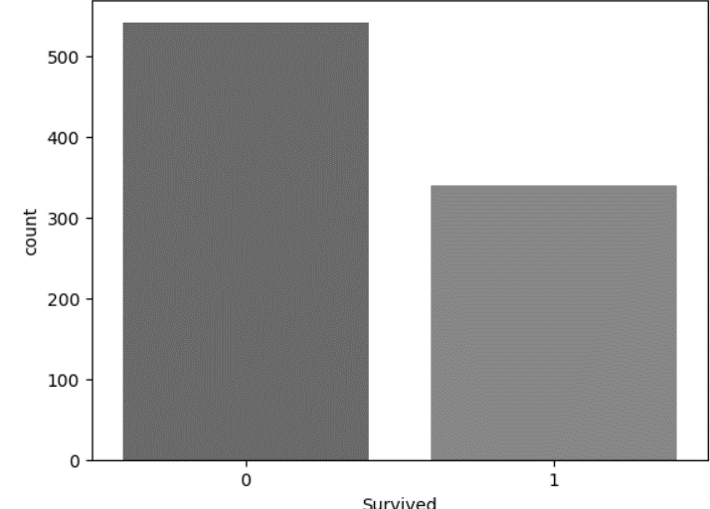
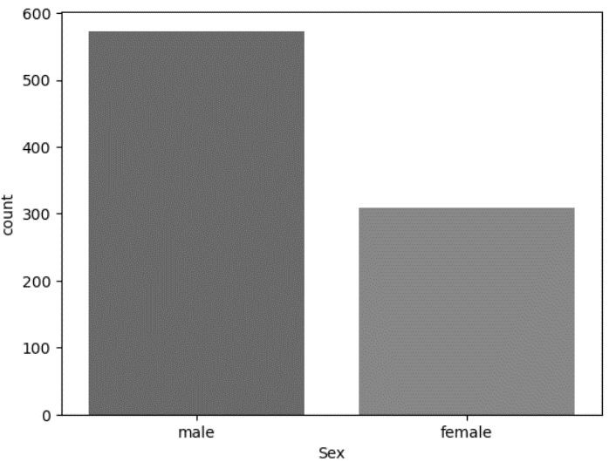
Survival Analysis
Survival Rates by Gender
Female: Higher survival rate. Male: Lower survival rate.
Survival Rates by Class
First Class: Highest survival rate. Third Class: Lowest survival rate.
Visualizations
Bar plots and pie charts depicting survival rates.

Slide 7
Model Building
Algorithms Used | Evaluation Metrics | Model Performance
Logistic Regression | Accuracy, Precision, Recall, F1 Score | Performance metrics for each algorithm.
Random Forest |  | Confusion matrix and ROC curves.
Support Vector Machine |  | Best Model: Random Forest with highest accuracy and balanced metrics.

Slide 8
Profiles
Name | Ijaz Khan
Email ID | ijazkhan121225@gmail.com
Phone Number | +919791057254
LinkedIn | https://www.linkedin.com/in/ijaz-khan-35659a251
GitHub | https://github.com/Ijazfa

Slide 9


